Slide 1


Thank you
Lecture 9: Introduction to Risk and Return - Review
The Basics of Statistics
Presentation to Cox Business Students
FINA 3320: Financial Management

Slide 2
Purpose of This Lecture
Provide an introduction to the concepts or risk and rates of return
    (1) Review of relevant material
    (2) Discussion of what’s to come
    (3) Basic statistics of risk and return
    (4) Risks and returns of different assets
    (5) Diversification
Notes:
Understanding Media: Extensions of Man, published in 1964.
The medium you use to send a particular message automatically predisposes audience members to make certain tacit assumptions about the message before they even read it.
Put another way, people unconsciously judge books by their covers.
How does this apply to business communications?
If you want to announce cutbacks in your company’s health benefits, don’t deliver the message with a glitzy, over-the-top, no-expenses-spared campaign.
Conversely, if you want to position your company as a leader in innovation, don’t advertise your message on sandwich boards dangling from the necks of ragamuffins traipsing around in front of gas stations.

Slide 3
Review
Value Created (Destroyed) = PV_{inflows} - PV_{outflows}
    Mechanically, the calculation is simple
    Determining the inputs for the calculation is much more difficult
Two main inputs for discounted cash flow analysis
    Cash flows
    Discount rate
Notes:
Understanding Media: Extensions of Man, published in 1964.
The medium you use to send a particular message automatically predisposes audience members to make certain tacit assumptions about the message before they even read it.
Put another way, people unconsciously judge books by their covers.
How does this apply to business communications?
If you want to announce cutbacks in your company’s health benefits, don’t deliver the message with a glitzy, over-the-top, no-expenses-spared campaign.
Conversely, if you want to position your company as a leader in innovation, don’t advertise your message on sandwich boards dangling from the necks of ragamuffins traipsing around in front of gas stations.

Slide 4
Intuition on the Discount Rate
Investors prefer dollars today to dollars in the future (time preferences)
  Rather consume (or invest) now than later
  Suggests discount rate should be positive
Investors don’t like risk (risk aversion)
  They require compensation for taking risks in the form of a higher expected return
  Also suggests a positive discount rate
Notes:
Understanding Media: Extensions of Man, published in 1964.
The medium you use to send a particular message automatically predisposes audience members to make certain tacit assumptions about the message before they even read it.
Put another way, people unconsciously judge books by their covers.
How does this apply to business communications?
If you want to announce cutbacks in your company’s health benefits, don’t deliver the message with a glitzy, over-the-top, no-expenses-spared campaign.
Conversely, if you want to position your company as a leader in innovation, don’t advertise your message on sandwich boards dangling from the necks of ragamuffins traipsing around in front of gas stations.

Slide 5
Two Basic Components of Discount rate
Time preferences suggest a positive component to all discount rates
  Call this the risk-free rate (remember the last lecture?!?)
Risk aversion suggests an additional component representative of the asset’s risk
  Call this the risk premium
Variation in discount rates across assets is really variation in risk premia (the second component)
  Riskier assets should have a higher risk premium
  In capital budgeting (discussed a couple of lectures from now), riskier projects should be valued with a higher discount rate
Notes:
Understanding Media: Extensions of Man, published in 1964.
The medium you use to send a particular message automatically predisposes audience members to make certain tacit assumptions about the message before they even read it.
Put another way, people unconsciously judge books by their covers.
How does this apply to business communications?
If you want to announce cutbacks in your company’s health benefits, don’t deliver the message with a glitzy, over-the-top, no-expenses-spared campaign.
Conversely, if you want to position your company as a leader in innovation, don’t advertise your message on sandwich boards dangling from the necks of ragamuffins traipsing around in front of gas stations.

Slide 6
The Discussion Ahead
Consider a simple definition of risk
Write down quantitative measures of risk
Discuss how risk is actually related to expected return
Discuss capital budgeting
Notes:
Understanding Media: Extensions of Man, published in 1964.
The medium you use to send a particular message automatically predisposes audience members to make certain tacit assumptions about the message before they even read it.
Put another way, people unconsciously judge books by their covers.
How does this apply to business communications?
If you want to announce cutbacks in your company’s health benefits, don’t deliver the message with a glitzy, over-the-top, no-expenses-spared campaign.
Conversely, if you want to position your company as a leader in innovation, don’t advertise your message on sandwich boards dangling from the necks of ragamuffins traipsing around in front of gas stations.

Slide 7
What is Risk?
Webster defines as “a hazard; a peril; exposure to loss or injury”
Risk loosely refers to dispersion in possible outcomes (some better than others)
  No dispersion = no risk (receive the same percentage return no matter what)
  Greater dispersion = greater risk
Consider a histogram
  Plots probabilities of all possible outcomes
  Represents a picture of the dispersion in outcomes
  Wider distribution = more risk
Notes:
Understanding Media: Extensions of Man, published in 1964.
The medium you use to send a particular message automatically predisposes audience members to make certain tacit assumptions about the message before they even read it.
Put another way, people unconsciously judge books by their covers.
How does this apply to business communications?
If you want to announce cutbacks in your company’s health benefits, don’t deliver the message with a glitzy, over-the-top, no-expenses-spared campaign.
Conversely, if you want to position your company as a leader in innovation, don’t advertise your message on sandwich boards dangling from the necks of ragamuffins traipsing around in front of gas stations.

Slide 8
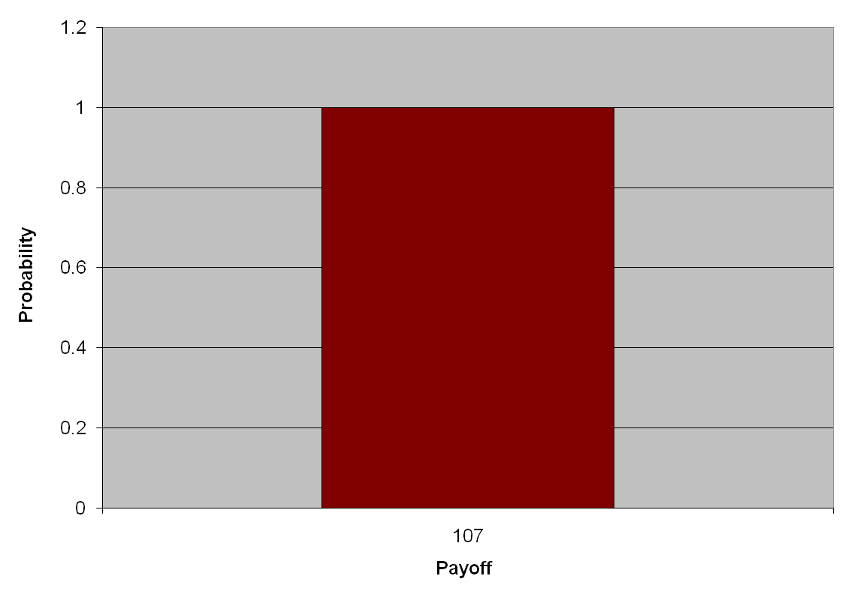
Asset A
Notes:
Understanding Media: Extensions of Man, published in 1964.
The medium you use to send a particular message automatically predisposes audience members to make certain tacit assumptions about the message before they even read it.
Put another way, people unconsciously judge books by their covers.
How does this apply to business communications?
If you want to announce cutbacks in your company’s health benefits, don’t deliver the message with a glitzy, over-the-top, no-expenses-spared campaign.
Conversely, if you want to position your company as a leader in innovation, don’t advertise your message on sandwich boards dangling from the necks of ragamuffins traipsing around in front of gas stations.

Slide 9
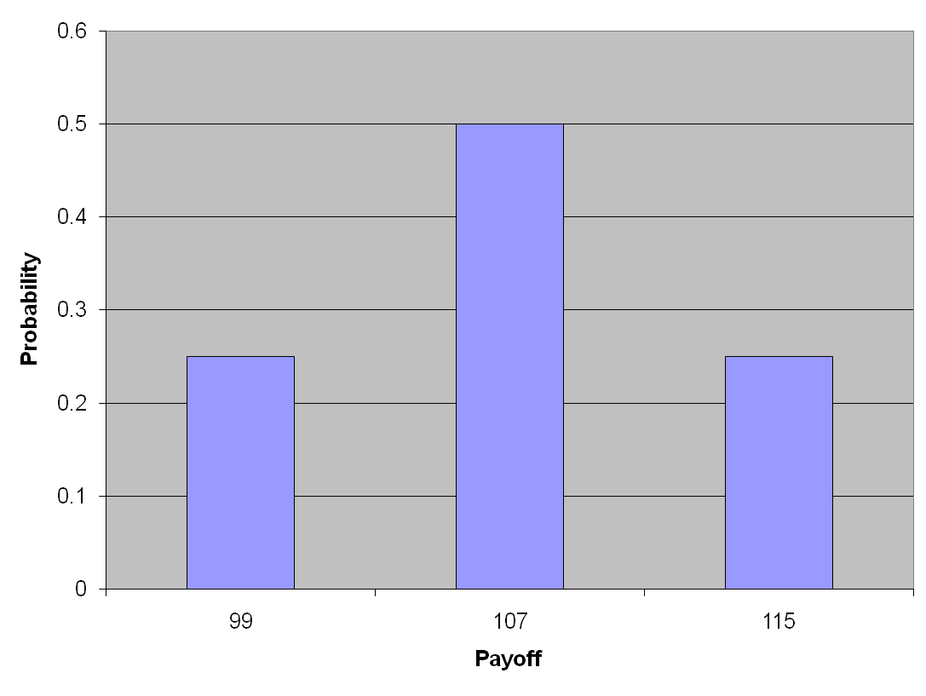
Asset B
Notes:
Understanding Media: Extensions of Man, published in 1964.
The medium you use to send a particular message automatically predisposes audience members to make certain tacit assumptions about the message before they even read it.
Put another way, people unconsciously judge books by their covers.
How does this apply to business communications?
If you want to announce cutbacks in your company’s health benefits, don’t deliver the message with a glitzy, over-the-top, no-expenses-spared campaign.
Conversely, if you want to position your company as a leader in innovation, don’t advertise your message on sandwich boards dangling from the necks of ragamuffins traipsing around in front of gas stations.

Slide 10
Which Asset is Riskier?
Asset A provides a single point in terms of payoff
  Expected payoff based on histogram is $107
  Probability of this payoff is 1 (i.e., 100%)
Asset B has several potential payoffs
  Expected payoffs based on histogram are $99, $107, $115
  Probability of payoffs of $99 and $115 are each 25%
  Probability of payoff of $107 is 50%
Which asset is riskier?
Why?
Notes:
Understanding Media: Extensions of Man, published in 1964.
The medium you use to send a particular message automatically predisposes audience members to make certain tacit assumptions about the message before they even read it.
Put another way, people unconsciously judge books by their covers.
How does this apply to business communications?
If you want to announce cutbacks in your company’s health benefits, don’t deliver the message with a glitzy, over-the-top, no-expenses-spared campaign.
Conversely, if you want to position your company as a leader in innovation, don’t advertise your message on sandwich boards dangling from the necks of ragamuffins traipsing around in front of gas stations.

Slide 11
Expected Versus Realized Rates of Return
Expected rate of return (ex ante):
  Calculated by multiplying each possible outcome by its probability of occurrence and then summing these products
  Weighted average of outcomes where the weights are the probabilities and weighted average is the expected rate of return
Realized rate of return (ex post):
  Actual rate of return earned during some past period
  Can be considered the “after-the-fact” rate of return
Realized rate of return is often different from the expected rate of return
  However, on average, these two tend to be fairly close!
Notes:
Understanding Media: Extensions of Man, published in 1964.
The medium you use to send a particular message automatically predisposes audience members to make certain tacit assumptions about the message before they even read it.
Put another way, people unconsciously judge books by their covers.
How does this apply to business communications?
If you want to announce cutbacks in your company’s health benefits, don’t deliver the message with a glitzy, over-the-top, no-expenses-spared campaign.
Conversely, if you want to position your company as a leader in innovation, don’t advertise your message on sandwich boards dangling from the necks of ragamuffins traipsing around in front of gas stations.

Slide 12
Expected Returns and Risk: An Example
Let us first consider an example of expected rate of return (or ex ante returns):
  Calculated by multiplying each possible outcome by its probability of occurrence and then summing these products
  Weighted average of outcomes where the weights are the probabilities and weighted average is the expected rate of return
Let us also consider risk in our example
Notes:
Understanding Media: Extensions of Man, published in 1964.
The medium you use to send a particular message automatically predisposes audience members to make certain tacit assumptions about the message before they even read it.
Put another way, people unconsciously judge books by their covers.
How does this apply to business communications?
If you want to announce cutbacks in your company’s health benefits, don’t deliver the message with a glitzy, over-the-top, no-expenses-spared campaign.
Conversely, if you want to position your company as a leader in innovation, don’t advertise your message on sandwich boards dangling from the necks of ragamuffins traipsing around in front of gas stations.

Slide 13
Holding Period Returns (HPR)
Risk means uncertainty about what an investor’s realized holding period return will be
  i.e., that realized returns will differ from expected returns
We can quantify the uncertainty using probability distributions
Example (Stock Fund or SF):
  Assume there is considerable uncertainty with respect to the end of year price of an index stock fund, which is currently selling for $100
  Also, the investor expects a dividend of $4
Notes:
Understanding Media: Extensions of Man, published in 1964.
The medium you use to send a particular message automatically predisposes audience members to make certain tacit assumptions about the message before they even read it.
Put another way, people unconsciously judge books by their covers.
How does this apply to business communications?
If you want to announce cutbacks in your company’s health benefits, don’t deliver the message with a glitzy, over-the-top, no-expenses-spared campaign.
Conversely, if you want to position your company as a leader in innovation, don’t advertise your message on sandwich boards dangling from the necks of ragamuffins traipsing around in front of gas stations.

Slide 14
Holding Period Returns (HPR): SF Example
State of the Economy | Prob. | Ending Price | HPR
Boom | .25 | $140 | 44%
Normal Growth | .50 | $110 | 14%
Recession | .25 | $80 | -16%
Notes:
Understanding Media: Extensions of Man, published in 1964.
The medium you use to send a particular message automatically predisposes audience members to make certain tacit assumptions about the message before they even read it.
Put another way, people unconsciously judge books by their covers.
How does this apply to business communications?
If you want to announce cutbacks in your company’s health benefits, don’t deliver the message with a glitzy, over-the-top, no-expenses-spared campaign.
Conversely, if you want to position your company as a leader in innovation, don’t advertise your message on sandwich boards dangling from the necks of ragamuffins traipsing around in front of gas stations.

Slide 15
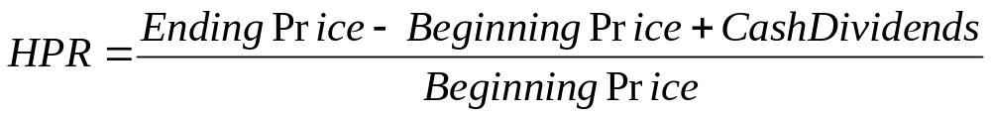
Holding Period Returns (HPR): SF Example
Holding Period Return Formula
Holding Period Return: Boom
Holding Period Return: Normal
Holding Period Return: Recession
Notes:
Understanding Media: Extensions of Man, published in 1964.
The medium you use to send a particular message automatically predisposes audience members to make certain tacit assumptions about the message before they even read it.
Put another way, people unconsciously judge books by their covers.
How does this apply to business communications?
If you want to announce cutbacks in your company’s health benefits, don’t deliver the message with a glitzy, over-the-top, no-expenses-spared campaign.
Conversely, if you want to position your company as a leader in innovation, don’t advertise your message on sandwich boards dangling from the necks of ragamuffins traipsing around in front of gas stations.

Slide 16
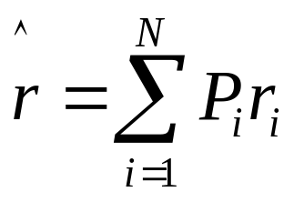
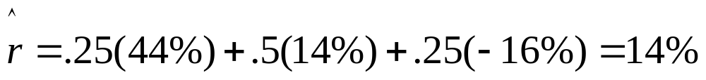
Expected Returns: SF Example
Expected Return Equation
  The expected return (mean) is the probability weighted average of all possible outcomes
Notes:
Understanding Media: Extensions of Man, published in 1964.
The medium you use to send a particular message automatically predisposes audience members to make certain tacit assumptions about the message before they even read it.
Put another way, people unconsciously judge books by their covers.
How does this apply to business communications?
If you want to announce cutbacks in your company’s health benefits, don’t deliver the message with a glitzy, over-the-top, no-expenses-spared campaign.
Conversely, if you want to position your company as a leader in innovation, don’t advertise your message on sandwich boards dangling from the necks of ragamuffins traipsing around in front of gas stations.

Slide 17
Measuring Risk
Variance = average squared deviation from the mean
  Represents the dispersion of a given distribution
  Variance is a natural measure of risk
Standard deviation = square root of variance
  Higher variance (or standard deviation) represents greater dispersion and, hence, greater risk
Notes:
Understanding Media: Extensions of Man, published in 1964.
The medium you use to send a particular message automatically predisposes audience members to make certain tacit assumptions about the message before they even read it.
Put another way, people unconsciously judge books by their covers.
How does this apply to business communications?
If you want to announce cutbacks in your company’s health benefits, don’t deliver the message with a glitzy, over-the-top, no-expenses-spared campaign.
Conversely, if you want to position your company as a leader in innovation, don’t advertise your message on sandwich boards dangling from the necks of ragamuffins traipsing around in front of gas stations.

Slide 18
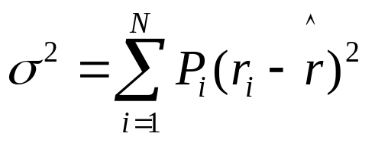
Computing Variance: SF Example
The Variance Equation
The variance for our example can be calculated as follows:
Or in table form…
Notes:
Understanding Media: Extensions of Man, published in 1964.
The medium you use to send a particular message automatically predisposes audience members to make certain tacit assumptions about the message before they even read it.
Put another way, people unconsciously judge books by their covers.
How does this apply to business communications?
If you want to announce cutbacks in your company’s health benefits, don’t deliver the message with a glitzy, over-the-top, no-expenses-spared campaign.
Conversely, if you want to position your company as a leader in innovation, don’t advertise your message on sandwich boards dangling from the necks of ragamuffins traipsing around in front of gas stations.

Slide 19
Computing Variance: SF Example
Probability
Return
Prob x Return
Deviation
Prob x Sq Dev
0.25
0.44
0.11
0.300
0.0225
0.50
0.14
0.07
0.000
0.0000
0.25
-0.16
-0.04
-0.300
0.0225
Mean =
0.14
Variance =
0.0450
Notes:
Understanding Media: Extensions of Man, published in 1964.
The medium you use to send a particular message automatically predisposes audience members to make certain tacit assumptions about the message before they even read it.
Put another way, people unconsciously judge books by their covers.
How does this apply to business communications?
If you want to announce cutbacks in your company’s health benefits, don’t deliver the message with a glitzy, over-the-top, no-expenses-spared campaign.
Conversely, if you want to position your company as a leader in innovation, don’t advertise your message on sandwich boards dangling from the necks of ragamuffins traipsing around in front of gas stations.

Slide 20
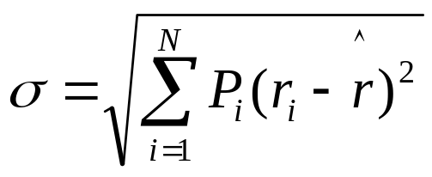
Computing Standard Deviation: SF Example
The standard deviation is the square root of the variance
The equation is:
The standard deviation of our example follows:
Notes:
Understanding Media: Extensions of Man, published in 1964.
The medium you use to send a particular message automatically predisposes audience members to make certain tacit assumptions about the message before they even read it.
Put another way, people unconsciously judge books by their covers.
How does this apply to business communications?
If you want to announce cutbacks in your company’s health benefits, don’t deliver the message with a glitzy, over-the-top, no-expenses-spared campaign.
Conversely, if you want to position your company as a leader in innovation, don’t advertise your message on sandwich boards dangling from the necks of ragamuffins traipsing around in front of gas stations.

Slide 21
Computing Standard Deviation: SF Example
Probability
Return
Prob x Return
Deviation
Prob x Sq Dev
0.25
0.44
0.11
0.300
0.0225
0.50
0.14
0.07
0.000
0.0000
0.25
-0.16
-0.04
-0.300
0.0225
Mean =
0.14
Variance =
0.0450
Std Deviation =
0.2121
Notes:
Understanding Media: Extensions of Man, published in 1964.
The medium you use to send a particular message automatically predisposes audience members to make certain tacit assumptions about the message before they even read it.
Put another way, people unconsciously judge books by their covers.
How does this apply to business communications?
If you want to announce cutbacks in your company’s health benefits, don’t deliver the message with a glitzy, over-the-top, no-expenses-spared campaign.
Conversely, if you want to position your company as a leader in innovation, don’t advertise your message on sandwich boards dangling from the necks of ragamuffins traipsing around in front of gas stations.

Slide 22
Risk Premium: Example
Would the investment in our Stock Fund (SF) example be attractive to a risk averse investor?
The answer to this question will, in general, depend on the risk premium it affords
The risk premium is the excess of the expected return over the risk-free rate.
The proxy for the risk-free rate is the rate on short-term T-bills
Notes:
Understanding Media: Extensions of Man, published in 1964.
The medium you use to send a particular message automatically predisposes audience members to make certain tacit assumptions about the message before they even read it.
Put another way, people unconsciously judge books by their covers.
How does this apply to business communications?
If you want to announce cutbacks in your company’s health benefits, don’t deliver the message with a glitzy, over-the-top, no-expenses-spared campaign.
Conversely, if you want to position your company as a leader in innovation, don’t advertise your message on sandwich boards dangling from the necks of ragamuffins traipsing around in front of gas stations.

Slide 23
Risk Premium: SF Example
Assume the risk-free rate (i.e., the rate of return on a short-term T-bill) is 4%
Example Summary: Expected Return = 14%
Variance = 4.5%
Standard Deviation = 21.21%
Would the investment in our SF example be attractive to you as an investor?
What does your answer say about your level of risk aversion?
Notes:
Understanding Media: Extensions of Man, published in 1964.
The medium you use to send a particular message automatically predisposes audience members to make certain tacit assumptions about the message before they even read it.
Put another way, people unconsciously judge books by their covers.
How does this apply to business communications?
If you want to announce cutbacks in your company’s health benefits, don’t deliver the message with a glitzy, over-the-top, no-expenses-spared campaign.
Conversely, if you want to position your company as a leader in innovation, don’t advertise your message on sandwich boards dangling from the necks of ragamuffins traipsing around in front of gas stations.

Slide 24
Realized Returns and Risk: Example
Let us now consider an example of realized rates of return (or ex post returns):
  Calculation: Given! Since these are realized returns!!
Considering risk with realized returns (i.e., using historical data, or sample return data)…
  Requires calculation of sample variance and/or sample standard deviation
Notes:
Understanding Media: Extensions of Man, published in 1964.
The medium you use to send a particular message automatically predisposes audience members to make certain tacit assumptions about the message before they even read it.
Put another way, people unconsciously judge books by their covers.
How does this apply to business communications?
If you want to announce cutbacks in your company’s health benefits, don’t deliver the message with a glitzy, over-the-top, no-expenses-spared campaign.
Conversely, if you want to position your company as a leader in innovation, don’t advertise your message on sandwich boards dangling from the necks of ragamuffins traipsing around in front of gas stations.

Slide 25
Realized Returns and Risk: Example
Again, risk means uncertainty about what an investor’s realized holding period returns will be ex ante
However, using historic (ex post) returns from sample data, there is no probability distribution
  Remember, realized returns are after-the-fact returns
Example (Two Stocks):
  Assume we have 5 years of annual realized returns for Stock A and Stock B
  How can we determine the average realized return and ex post risk (in terms of sample variance and sample standard deviation)
Notes:
Understanding Media: Extensions of Man, published in 1964.
The medium you use to send a particular message automatically predisposes audience members to make certain tacit assumptions about the message before they even read it.
Put another way, people unconsciously judge books by their covers.
How does this apply to business communications?
If you want to announce cutbacks in your company’s health benefits, don’t deliver the message with a glitzy, over-the-top, no-expenses-spared campaign.
Conversely, if you want to position your company as a leader in innovation, don’t advertise your message on sandwich boards dangling from the necks of ragamuffins traipsing around in front of gas stations.

Slide 26
Realized Returns and Risk: Example
Year Stock A Return Stock B Return
2003 0.04 0.02
2004 -0.02 0.03
2005 0.08 0.06
2006 -0.04 -0.04
2007 0.04 0.08
What is the average realized rate of return for each stock using the sample data above?
What risk measure can we calculate using the sample data above?
Notes:
Understanding Media: Extensions of Man, published in 1964.
The medium you use to send a particular message automatically predisposes audience members to make certain tacit assumptions about the message before they even read it.
Put another way, people unconsciously judge books by their covers.
How does this apply to business communications?
If you want to announce cutbacks in your company’s health benefits, don’t deliver the message with a glitzy, over-the-top, no-expenses-spared campaign.
Conversely, if you want to position your company as a leader in innovation, don’t advertise your message on sandwich boards dangling from the necks of ragamuffins traipsing around in front of gas stations.

Slide 27
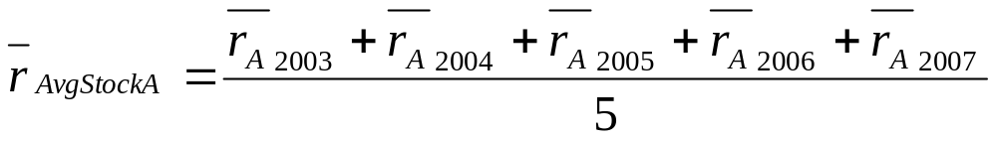
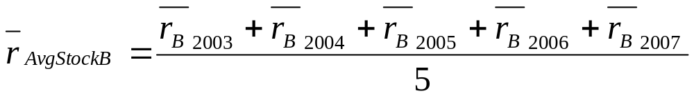
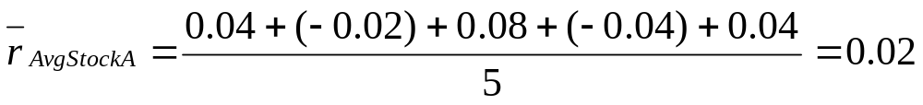
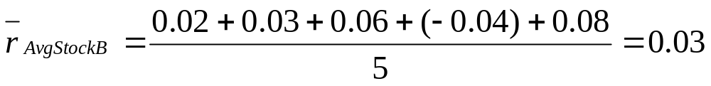
Average (Mean) Realized Returns: Example
What is the average realized rate of return for Stock A and Stock B using the sample data?
Notes:
Understanding Media: Extensions of Man, published in 1964.
The medium you use to send a particular message automatically predisposes audience members to make certain tacit assumptions about the message before they even read it.
Put another way, people unconsciously judge books by their covers.
How does this apply to business communications?
If you want to announce cutbacks in your company’s health benefits, don’t deliver the message with a glitzy, over-the-top, no-expenses-spared campaign.
Conversely, if you want to position your company as a leader in innovation, don’t advertise your message on sandwich boards dangling from the necks of ragamuffins traipsing around in front of gas stations.

Slide 28
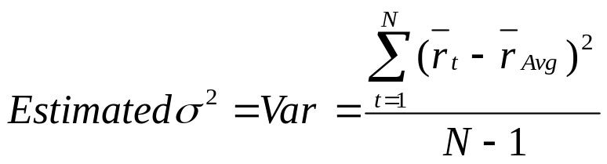


Computing Sample Variance: Example
What is the sample variance for Stock A and Stock B using the sample data?
Notes:
Understanding Media: Extensions of Man, published in 1964.
The medium you use to send a particular message automatically predisposes audience members to make certain tacit assumptions about the message before they even read it.
Put another way, people unconsciously judge books by their covers.
How does this apply to business communications?
If you want to announce cutbacks in your company’s health benefits, don’t deliver the message with a glitzy, over-the-top, no-expenses-spared campaign.
Conversely, if you want to position your company as a leader in innovation, don’t advertise your message on sandwich boards dangling from the necks of ragamuffins traipsing around in front of gas stations.

Slide 29
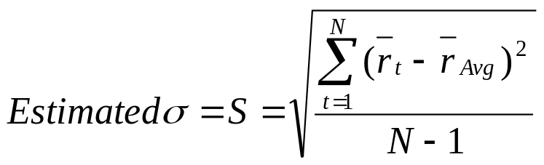


Computing Sample Standard Deviation: Example
What is the sample standard deviation for Stock A and Stock B using the sample data?
Notes:
Understanding Media: Extensions of Man, published in 1964.
The medium you use to send a particular message automatically predisposes audience members to make certain tacit assumptions about the message before they even read it.
Put another way, people unconsciously judge books by their covers.
How does this apply to business communications?
If you want to announce cutbacks in your company’s health benefits, don’t deliver the message with a glitzy, over-the-top, no-expenses-spared campaign.
Conversely, if you want to position your company as a leader in innovation, don’t advertise your message on sandwich boards dangling from the necks of ragamuffins traipsing around in front of gas stations.

Slide 30
Realized Returns and Risk: Example
Covariance: New Concept in Risk Measurement
Consider our two stocks again: Stock A and Stock B
The measure of co-movement between these two stocks is called the covariance
  Covariance is the expected value of the products of deviations from the sample means
In practice, we must estimate the covariance
Notes:
Understanding Media: Extensions of Man, published in 1964.
The medium you use to send a particular message automatically predisposes audience members to make certain tacit assumptions about the message before they even read it.
Put another way, people unconsciously judge books by their covers.
How does this apply to business communications?
If you want to announce cutbacks in your company’s health benefits, don’t deliver the message with a glitzy, over-the-top, no-expenses-spared campaign.
Conversely, if you want to position your company as a leader in innovation, don’t advertise your message on sandwich boards dangling from the necks of ragamuffins traipsing around in front of gas stations.

Slide 31
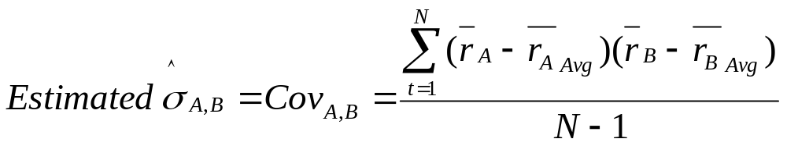

Realized Returns and Risk: Example
Covariance: New Concept in Risk Measurement
Consider our two stocks again: Stock A and Stock B
Note: As we will see, covariance is a very important concept!
Notes:
Understanding Media: Extensions of Man, published in 1964.
The medium you use to send a particular message automatically predisposes audience members to make certain tacit assumptions about the message before they even read it.
Put another way, people unconsciously judge books by their covers.
How does this apply to business communications?
If you want to announce cutbacks in your company’s health benefits, don’t deliver the message with a glitzy, over-the-top, no-expenses-spared campaign.
Conversely, if you want to position your company as a leader in innovation, don’t advertise your message on sandwich boards dangling from the necks of ragamuffins traipsing around in front of gas stations.

Slide 32
Realized Returns and Risk: Example
Correlation: New Concept in Risk Measurement
Consider our two stocks again: Stock A and Stock B
The tendency for two stocks to move together is called correlation
The correlation coefficient , ρ, (pronounced “rho”) measures this tendency
  If the returns on Stock A and B are perfectly positively correlated, they would have a ρ = 1.0
  If the returns on Stock A and B are perfectly negatively correlated, they would have a ρ = -1.0
Notes:
Understanding Media: Extensions of Man, published in 1964.
The medium you use to send a particular message automatically predisposes audience members to make certain tacit assumptions about the message before they even read it.
Put another way, people unconsciously judge books by their covers.
How does this apply to business communications?
If you want to announce cutbacks in your company’s health benefits, don’t deliver the message with a glitzy, over-the-top, no-expenses-spared campaign.
Conversely, if you want to position your company as a leader in innovation, don’t advertise your message on sandwich boards dangling from the necks of ragamuffins traipsing around in front of gas stations.

Slide 33
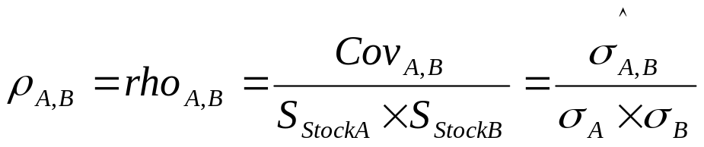
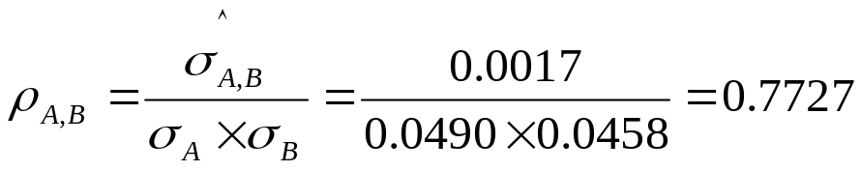
Realized Returns and Risk: Example
Correlation: New Concept in Risk Measurement
Consider our two stocks again: Stock A and Stock B
Notes:
Understanding Media: Extensions of Man, published in 1964.
The medium you use to send a particular message automatically predisposes audience members to make certain tacit assumptions about the message before they even read it.
Put another way, people unconsciously judge books by their covers.
How does this apply to business communications?
If you want to announce cutbacks in your company’s health benefits, don’t deliver the message with a glitzy, over-the-top, no-expenses-spared campaign.
Conversely, if you want to position your company as a leader in innovation, don’t advertise your message on sandwich boards dangling from the necks of ragamuffins traipsing around in front of gas stations.

Slide 34
Risk and Return of Different Asset Classes
Consider stocks, long-term T-bonds, and T-bills
  Which do you expect to be riskier? Why?
  Which should have higher expected returns? Why?
Implementation notes:
  The risk-return tradeoff is an ex ante concept in that it involves expected returns
  Expected returns are immeasurable (because not observable)
  We often rely on ex post (realized) returns as a proxy
  Assumption: On average, expected returns will be realized
Notes:
Understanding Media: Extensions of Man, published in 1964.
The medium you use to send a particular message automatically predisposes audience members to make certain tacit assumptions about the message before they even read it.
Put another way, people unconsciously judge books by their covers.
How does this apply to business communications?
If you want to announce cutbacks in your company’s health benefits, don’t deliver the message with a glitzy, over-the-top, no-expenses-spared campaign.
Conversely, if you want to position your company as a leader in innovation, don’t advertise your message on sandwich boards dangling from the necks of ragamuffins traipsing around in front of gas stations.

Slide 35
Value of $1 Invested in 1900
100000
10000
Common Stocks
1000
Long T-Bonds
T-Bills
100
10
1
1900
1910
1920
1930
1940
1950
1960
1970
1980
1990
2000
Notes:
Understanding Media: Extensions of Man, published in 1964.
The medium you use to send a particular message automatically predisposes audience members to make certain tacit assumptions about the message before they even read it.
Put another way, people unconsciously judge books by their covers.
How does this apply to business communications?
If you want to announce cutbacks in your company’s health benefits, don’t deliver the message with a glitzy, over-the-top, no-expenses-spared campaign.
Conversely, if you want to position your company as a leader in innovation, don’t advertise your message on sandwich boards dangling from the necks of ragamuffins traipsing around in front of gas stations.

Slide 36
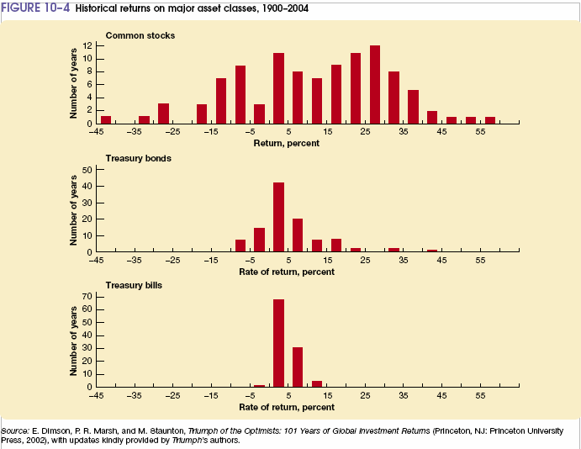
Histograms for Each Asset
Notes:
Understanding Media: Extensions of Man, published in 1964.
The medium you use to send a particular message automatically predisposes audience members to make certain tacit assumptions about the message before they even read it.
Put another way, people unconsciously judge books by their covers.
How does this apply to business communications?
If you want to announce cutbacks in your company’s health benefits, don’t deliver the message with a glitzy, over-the-top, no-expenses-spared campaign.
Conversely, if you want to position your company as a leader in innovation, don’t advertise your message on sandwich boards dangling from the necks of ragamuffins traipsing around in front of gas stations.

Slide 37
What is Stand-Alone Risk?
How is Stand-Alone Risk Measured?
Stand-alone risk is the risk an investor faces if he holds a single asset in isolation
  i.e., rather than as part of a portfolio of assets
Stand-alone risk can be measured as the coefficient of variation (CV)
  Coefficient of variation is the standard deviation divided by the expected return
  Coefficient of variation (CV) shows the risk per unit of return
  CV is used by investors to compare two or more alternative investments
Notes:
Understanding Media: Extensions of Man, published in 1964.
The medium you use to send a particular message automatically predisposes audience members to make certain tacit assumptions about the message before they even read it.
Put another way, people unconsciously judge books by their covers.
How does this apply to business communications?
If you want to announce cutbacks in your company’s health benefits, don’t deliver the message with a glitzy, over-the-top, no-expenses-spared campaign.
Conversely, if you want to position your company as a leader in innovation, don’t advertise your message on sandwich boards dangling from the necks of ragamuffins traipsing around in front of gas stations.

Slide 38
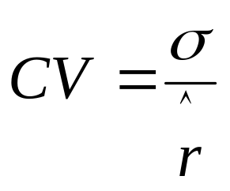
Coefficient of Variation (CV)
Stand-alone risk can be measured as the coefficient of variation (CV)
Coefficient of Variation equation follows:
Notes:
Understanding Media: Extensions of Man, published in 1964.
The medium you use to send a particular message automatically predisposes audience members to make certain tacit assumptions about the message before they even read it.
Put another way, people unconsciously judge books by their covers.
How does this apply to business communications?
If you want to announce cutbacks in your company’s health benefits, don’t deliver the message with a glitzy, over-the-top, no-expenses-spared campaign.
Conversely, if you want to position your company as a leader in innovation, don’t advertise your message on sandwich boards dangling from the necks of ragamuffins traipsing around in front of gas stations.

Slide 39



Coefficient of Variation (CV): Example
Assume you have the following three investment options:
  (1) A T-bill with the following attributes:
  (2) A Bond with the following attributes:
  (3) A Stock with the following attributes:
Notes:
Understanding Media: Extensions of Man, published in 1964.
The medium you use to send a particular message automatically predisposes audience members to make certain tacit assumptions about the message before they even read it.
Put another way, people unconsciously judge books by their covers.
How does this apply to business communications?
If you want to announce cutbacks in your company’s health benefits, don’t deliver the message with a glitzy, over-the-top, no-expenses-spared campaign.
Conversely, if you want to position your company as a leader in innovation, don’t advertise your message on sandwich boards dangling from the necks of ragamuffins traipsing around in front of gas stations.

Slide 40
Coefficient of Variation (CV): Example cont…
Which would you select?
Why?
  (1) A T-bill with the following attributes:
  (2) A Bond with the following attributes:
  (3) A Stock with the following attributes:
Notes:
Understanding Media: Extensions of Man, published in 1964.
The medium you use to send a particular message automatically predisposes audience members to make certain tacit assumptions about the message before they even read it.
Put another way, people unconsciously judge books by their covers.
How does this apply to business communications?
If you want to announce cutbacks in your company’s health benefits, don’t deliver the message with a glitzy, over-the-top, no-expenses-spared campaign.
Conversely, if you want to position your company as a leader in innovation, don’t advertise your message on sandwich boards dangling from the necks of ragamuffins traipsing around in front of gas stations.

Slide 41
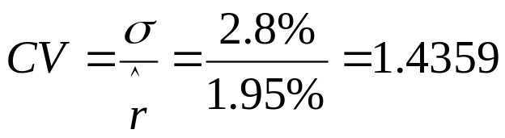
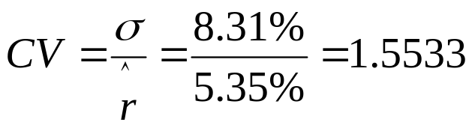
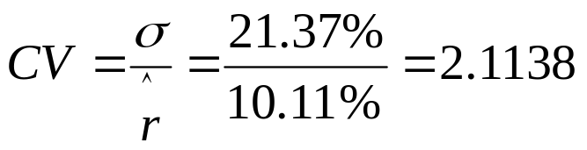
Coefficient of Variation (CV): Example cont…
  (1) T-bill:
  (2) Bond:
  (3) Stock:
Notes:
Understanding Media: Extensions of Man, published in 1964.
The medium you use to send a particular message automatically predisposes audience members to make certain tacit assumptions about the message before they even read it.
Put another way, people unconsciously judge books by their covers.
How does this apply to business communications?
If you want to announce cutbacks in your company’s health benefits, don’t deliver the message with a glitzy, over-the-top, no-expenses-spared campaign.
Conversely, if you want to position your company as a leader in innovation, don’t advertise your message on sandwich boards dangling from the necks of ragamuffins traipsing around in front of gas stations.

Slide 42
Portfolio Return
Portfolio Returns:
  To compute the return on a portfolio, first compute the return on each single asset making up the portfolio
  The return on the portfolio is the weighted average of the individual security returns
  The historical (ex post) average return is often used as a proxy for the expected (ex ante) returns
Example: Assume we have a portfolio made up of 40% of Stock A and 60% of Stock B
Notes:
Understanding Media: Extensions of Man, published in 1964.
The medium you use to send a particular message automatically predisposes audience members to make certain tacit assumptions about the message before they even read it.
Put another way, people unconsciously judge books by their covers.
How does this apply to business communications?
If you want to announce cutbacks in your company’s health benefits, don’t deliver the message with a glitzy, over-the-top, no-expenses-spared campaign.
Conversely, if you want to position your company as a leader in innovation, don’t advertise your message on sandwich boards dangling from the necks of ragamuffins traipsing around in front of gas stations.

Slide 43
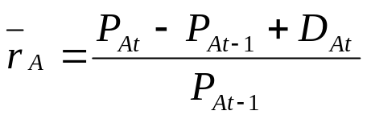
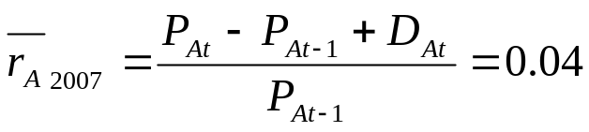
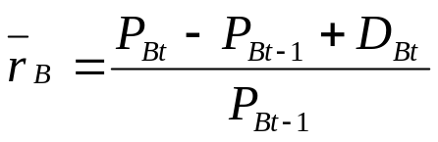
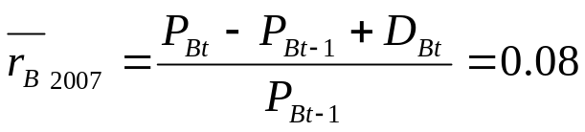
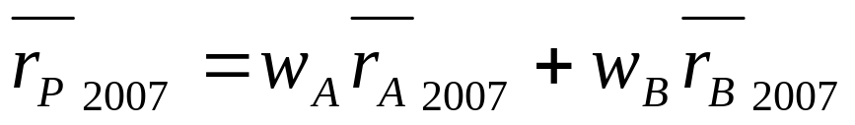
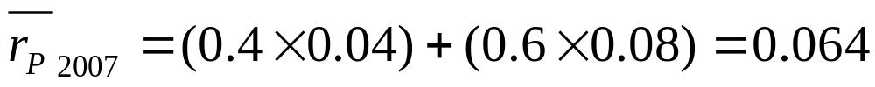
Portfolio Return: Example
Consider our example of Stock A and Stock B again:
Notes:
Understanding Media: Extensions of Man, published in 1964.
The medium you use to send a particular message automatically predisposes audience members to make certain tacit assumptions about the message before they even read it.
Put another way, people unconsciously judge books by their covers.
How does this apply to business communications?
If you want to announce cutbacks in your company’s health benefits, don’t deliver the message with a glitzy, over-the-top, no-expenses-spared campaign.
Conversely, if you want to position your company as a leader in innovation, don’t advertise your message on sandwich boards dangling from the necks of ragamuffins traipsing around in front of gas stations.

Slide 44
Risk in a Portfolio Context
Which will have a higher standard deviation – an individual asset (i.e., stand-alone asset) or a portfolio of assets?
Assume returns of different assets are not perfectly correlated
  Gains in some of the portfolio’s assets will offset losses in other assets
  End result: Return variability (i.e., variance or standard deviation) is reduced when assets are combined in a portfolio
Notes:
Understanding Media: Extensions of Man, published in 1964.
The medium you use to send a particular message automatically predisposes audience members to make certain tacit assumptions about the message before they even read it.
Put another way, people unconsciously judge books by their covers.
How does this apply to business communications?
If you want to announce cutbacks in your company’s health benefits, don’t deliver the message with a glitzy, over-the-top, no-expenses-spared campaign.
Conversely, if you want to position your company as a leader in innovation, don’t advertise your message on sandwich boards dangling from the necks of ragamuffins traipsing around in front of gas stations.

Slide 45
Risk in a Portfolio Context continued…
Assume an investor owns an asset and wishes to add another asset to create a portfolio
Question: What risk should the investor consider?
Answer: Fundamental principle of finance is that investor cannot assess the riskiness of an investment by examining only its own standard deviation!
Risk must always be considered in a portfolio context
  i.e., taking into account the standard deviation of the entire portfolio after adding the asset in question
Notes:
Understanding Media: Extensions of Man, published in 1964.
The medium you use to send a particular message automatically predisposes audience members to make certain tacit assumptions about the message before they even read it.
Put another way, people unconsciously judge books by their covers.
How does this apply to business communications?
If you want to announce cutbacks in your company’s health benefits, don’t deliver the message with a glitzy, over-the-top, no-expenses-spared campaign.
Conversely, if you want to position your company as a leader in innovation, don’t advertise your message on sandwich boards dangling from the necks of ragamuffins traipsing around in front of gas stations.

Slide 46
Risk in a Portfolio Context: New Example
Your $500,000 home will burn down with probability equal to 0.002 (i.e., 0.2%)
Your expected loss (due to your home burning down) is: 0.002 x $500,000 = $1,000
An insurance policy (no deductible) costs $1,100
(1) What is expected profit of investment in the policy?
(2) What is expected return of investment in the policy?
(3) What is standard deviation of profit of an investment in the policy?
Notes:
Understanding Media: Extensions of Man, published in 1964.
The medium you use to send a particular message automatically predisposes audience members to make certain tacit assumptions about the message before they even read it.
Put another way, people unconsciously judge books by their covers.
How does this apply to business communications?
If you want to announce cutbacks in your company’s health benefits, don’t deliver the message with a glitzy, over-the-top, no-expenses-spared campaign.
Conversely, if you want to position your company as a leader in innovation, don’t advertise your message on sandwich boards dangling from the necks of ragamuffins traipsing around in front of gas stations.

Slide 47
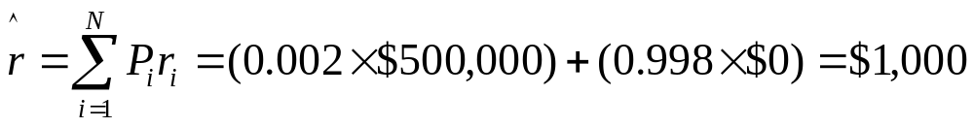
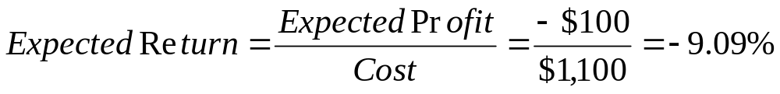
Risk in a Portfolio Context: New Example
(1) What is the expected profit of investment in the policy?
(2) What is the expected return on the policy?
Notes:
Understanding Media: Extensions of Man, published in 1964.
The medium you use to send a particular message automatically predisposes audience members to make certain tacit assumptions about the message before they even read it.
Put another way, people unconsciously judge books by their covers.
How does this apply to business communications?
If you want to announce cutbacks in your company’s health benefits, don’t deliver the message with a glitzy, over-the-top, no-expenses-spared campaign.
Conversely, if you want to position your company as a leader in innovation, don’t advertise your message on sandwich boards dangling from the necks of ragamuffins traipsing around in front of gas stations.

Slide 48
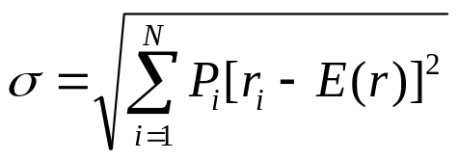
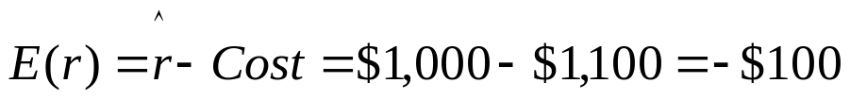

Risk in a Portfolio Context: New Example
(3) What is the standard deviation of profit of an investment in the policy?
  If your house burns down you get $498,900 (i.e., $500,000 - $1,100)
  If your house doesn’t burn down you get -$1,100
Notes:
Understanding Media: Extensions of Man, published in 1964.
The medium you use to send a particular message automatically predisposes audience members to make certain tacit assumptions about the message before they even read it.
Put another way, people unconsciously judge books by their covers.
How does this apply to business communications?
If you want to announce cutbacks in your company’s health benefits, don’t deliver the message with a glitzy, over-the-top, no-expenses-spared campaign.
Conversely, if you want to position your company as a leader in innovation, don’t advertise your message on sandwich boards dangling from the necks of ragamuffins traipsing around in front of gas stations.

Slide 49


Risk in a Portfolio Context: New Example
Who wants to buy an asset with a negative expected return and a high level of risk (as measured by standard deviation)?
Let’s see a show of hands! Raise your hand if you would purchase this asset!!
Notes:
Understanding Media: Extensions of Man, published in 1964.
The medium you use to send a particular message automatically predisposes audience members to make certain tacit assumptions about the message before they even read it.
Put another way, people unconsciously judge books by their covers.
How does this apply to business communications?
If you want to announce cutbacks in your company’s health benefits, don’t deliver the message with a glitzy, over-the-top, no-expenses-spared campaign.
Conversely, if you want to position your company as a leader in innovation, don’t advertise your message on sandwich boards dangling from the necks of ragamuffins traipsing around in front of gas stations.

Slide 50
Risk in a Portfolio Context: New Example
In fact, this may be a valuable addition to a portfolio because of its impact on portfolio risk
What is the standard deviation of the value of the complete portfolio, which consists of the following two assets?
  Asset 1: Your House
  Asset 2: The Insurance Policy
Notes:
Understanding Media: Extensions of Man, published in 1964.
The medium you use to send a particular message automatically predisposes audience members to make certain tacit assumptions about the message before they even read it.
Put another way, people unconsciously judge books by their covers.
How does this apply to business communications?
If you want to announce cutbacks in your company’s health benefits, don’t deliver the message with a glitzy, over-the-top, no-expenses-spared campaign.
Conversely, if you want to position your company as a leader in innovation, don’t advertise your message on sandwich boards dangling from the necks of ragamuffins traipsing around in front of gas stations.

Slide 51

Risk in a Portfolio Context: New Example
  Asset 1: Your House = $500,000
  Asset 2: The Insurance Policy = -$1,100
  If your house burns down, your portfolio would be worth $498,900 (i.e., $500,000 - $1,100
  And if your house doesn’t burn down, your portfolio is still worth $498,900 (i.e., $500,000 - $1,100)
  Therefore, the standard deviation of your portfolio would be:
Notes:
Understanding Media: Extensions of Man, published in 1964.
The medium you use to send a particular message automatically predisposes audience members to make certain tacit assumptions about the message before they even read it.
Put another way, people unconsciously judge books by their covers.
How does this apply to business communications?
If you want to announce cutbacks in your company’s health benefits, don’t deliver the message with a glitzy, over-the-top, no-expenses-spared campaign.
Conversely, if you want to position your company as a leader in innovation, don’t advertise your message on sandwich boards dangling from the necks of ragamuffins traipsing around in front of gas stations.

Slide 52
Diversification
Diversification is a strategy designed to reduce risk by spreading a portfolio across many assets
The riskiness of a portfolio is usually smaller than the average of the assets’ riskiness (i.e., average of assets’ σs)
This is true as long as the returns on the assets making up the portfolio are not perfectly correlated with one another
Notes:
Understanding Media: Extensions of Man, published in 1964.
The medium you use to send a particular message automatically predisposes audience members to make certain tacit assumptions about the message before they even read it.
Put another way, people unconsciously judge books by their covers.
How does this apply to business communications?
If you want to announce cutbacks in your company’s health benefits, don’t deliver the message with a glitzy, over-the-top, no-expenses-spared campaign.
Conversely, if you want to position your company as a leader in innovation, don’t advertise your message on sandwich boards dangling from the necks of ragamuffins traipsing around in front of gas stations.

Slide 53
Diversification…More Generally
The experiment:
  Select a stock at random and write down its standard deviation
  Select a second stock (also at random), put it in a portfolio with the first stock, and compute standard deviation (for the portfolio)
  Continue the process by selecting additional stocks, one at a time, and observe what happens to the risk of the portfolio
Plot portfolio standard deviation as a function of the number of securities in the portfolio
Notes:
Understanding Media: Extensions of Man, published in 1964.
The medium you use to send a particular message automatically predisposes audience members to make certain tacit assumptions about the message before they even read it.
Put another way, people unconsciously judge books by their covers.
How does this apply to business communications?
If you want to announce cutbacks in your company’s health benefits, don’t deliver the message with a glitzy, over-the-top, no-expenses-spared campaign.
Conversely, if you want to position your company as a leader in innovation, don’t advertise your message on sandwich boards dangling from the necks of ragamuffins traipsing around in front of gas stations.

Slide 54
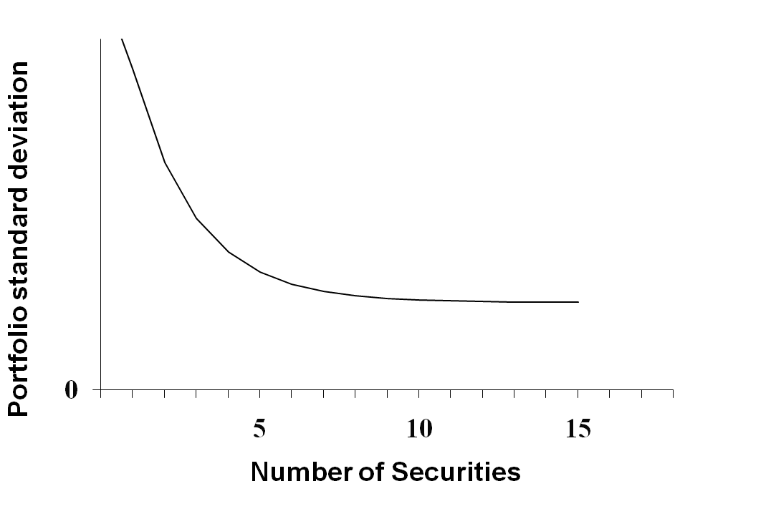
Diversification…More Generally
The experiment’s results:
Notes:
Understanding Media: Extensions of Man, published in 1964.
The medium you use to send a particular message automatically predisposes audience members to make certain tacit assumptions about the message before they even read it.
Put another way, people unconsciously judge books by their covers.
How does this apply to business communications?
If you want to announce cutbacks in your company’s health benefits, don’t deliver the message with a glitzy, over-the-top, no-expenses-spared campaign.
Conversely, if you want to position your company as a leader in innovation, don’t advertise your message on sandwich boards dangling from the necks of ragamuffins traipsing around in front of gas stations.

Slide 55
Risk and Diversification
Portfolio standard deviation falls to about 20% when 20 stocks are added to the portfolio
Some risk is diversifiable (i.e., it can be eliminated in a portfolio context) and is known as…
    …Firm-specific risk, also known as…
    …Idiosyncratic risk, also known as…
    …Diversifiable risk, also known as…
    …Unsystematic risk
Other risk is not diversifiable even in a portfolio…
    …Market risk, also known as…
    …Systematic risk, also known as…
    …Nondiversifiable risk
Notes:
Understanding Media: Extensions of Man, published in 1964.
The medium you use to send a particular message automatically predisposes audience members to make certain tacit assumptions about the message before they even read it.
Put another way, people unconsciously judge books by their covers.
How does this apply to business communications?
If you want to announce cutbacks in your company’s health benefits, don’t deliver the message with a glitzy, over-the-top, no-expenses-spared campaign.
Conversely, if you want to position your company as a leader in innovation, don’t advertise your message on sandwich boards dangling from the necks of ragamuffins traipsing around in front of gas stations.

Slide 56
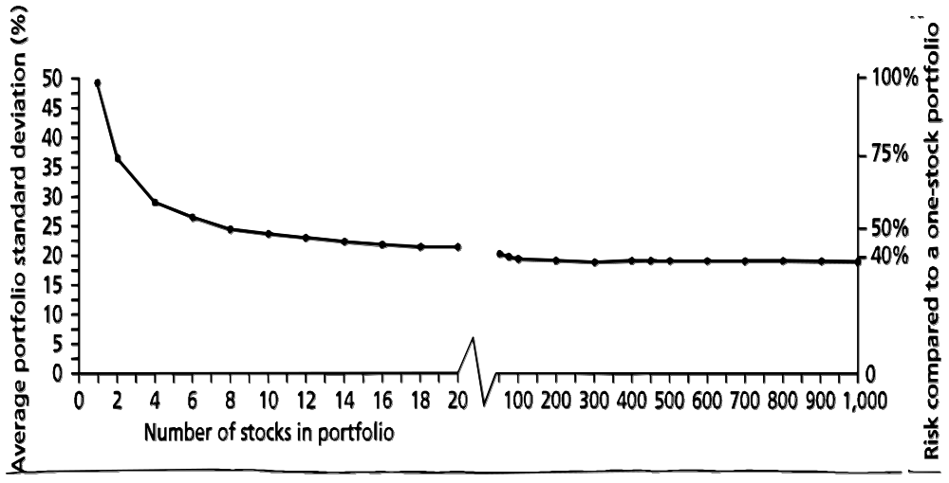
Risk and Diversification
Notes:
Understanding Media: Extensions of Man, published in 1964.
The medium you use to send a particular message automatically predisposes audience members to make certain tacit assumptions about the message before they even read it.
Put another way, people unconsciously judge books by their covers.
How does this apply to business communications?
If you want to announce cutbacks in your company’s health benefits, don’t deliver the message with a glitzy, over-the-top, no-expenses-spared campaign.
Conversely, if you want to position your company as a leader in innovation, don’t advertise your message on sandwich boards dangling from the necks of ragamuffins traipsing around in front of gas stations.

Slide 57
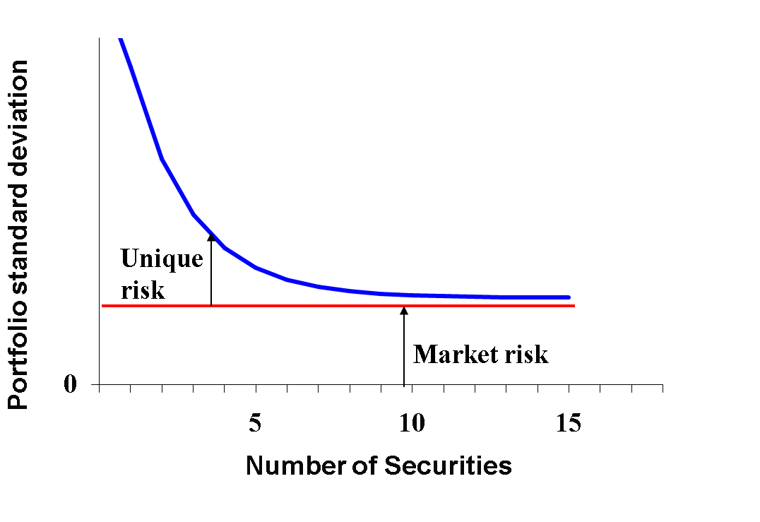
Risk and Diversification
Notes:
Understanding Media: Extensions of Man, published in 1964.
The medium you use to send a particular message automatically predisposes audience members to make certain tacit assumptions about the message before they even read it.
Put another way, people unconsciously judge books by their covers.
How does this apply to business communications?
If you want to announce cutbacks in your company’s health benefits, don’t deliver the message with a glitzy, over-the-top, no-expenses-spared campaign.
Conversely, if you want to position your company as a leader in innovation, don’t advertise your message on sandwich boards dangling from the necks of ragamuffins traipsing around in front of gas stations.

Slide 58
Risk and a Diversified Investor
An investor is only concerned with the risk of his overall portfolio
Implication: To a well-diversified investor, only systematic risk matters
On the risk-return tradeoff:
  Since idiosyncratic risk can be freely diversified away, investors cannot expect to be compensated for bearing it
  Investors only expect compensation for bearing systematic risk
Notes:
Understanding Media: Extensions of Man, published in 1964.
The medium you use to send a particular message automatically predisposes audience members to make certain tacit assumptions about the message before they even read it.
Put another way, people unconsciously judge books by their covers.
How does this apply to business communications?
If you want to announce cutbacks in your company’s health benefits, don’t deliver the message with a glitzy, over-the-top, no-expenses-spared campaign.
Conversely, if you want to position your company as a leader in innovation, don’t advertise your message on sandwich boards dangling from the necks of ragamuffins traipsing around in front of gas stations.

Slide 59
Risk and Expected Return
Variance (or standard deviation) of an individual asset measures total risk
  Includes both market risk and diversifiable risk
  Variance does not give us a good indication for what expected return should be
When determining an expected return, we need to quantify the asset’s systematic (market or nondiversifiable) risk and then form an estimate accordingly
Notes:
Understanding Media: Extensions of Man, published in 1964.
The medium you use to send a particular message automatically predisposes audience members to make certain tacit assumptions about the message before they even read it.
Put another way, people unconsciously judge books by their covers.
How does this apply to business communications?
If you want to announce cutbacks in your company’s health benefits, don’t deliver the message with a glitzy, over-the-top, no-expenses-spared campaign.
Conversely, if you want to position your company as a leader in innovation, don’t advertise your message on sandwich boards dangling from the necks of ragamuffins traipsing around in front of gas stations.

Slide 60
Thank you
Thank You!
Charles B. (Chip) Ruscher, PhD
Department of Finance and Business Economics

